Slide 1

UI Developement
Channel Overview
Proprietary and Confidential - © Blitz Digital Studios, LLC.

Slide 2
Overview
Any method of interaction between a person and device/machine
Touch
Sensors (IR, Motion, etc)
Remotes (Set top boxes)
Gestures/ Gloves
Proprietary and Confidential - © Blitz Digital Studios, LLC.

Slide 3
Touch
Traditional
Surface tables
Touch Screen Televisions
Kiosks
Non-traditional
Wall projected
Plastic film
Projected on surface
Proprietary and Confidential - © Blitz Digital Studios, LLC.

Slide 4
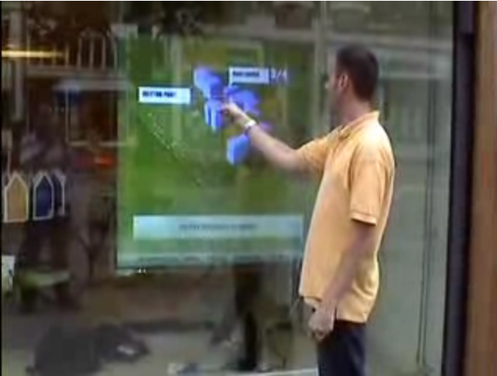
Wall Projected
Projected from in the store onto a surface.
Sensors in the front capture user interaction
basically a large touch screen monitor
http://tinyurl.com/23x255h
Example:
Proprietary and Confidential - © Blitz Digital Studios, LLC.

Slide 5
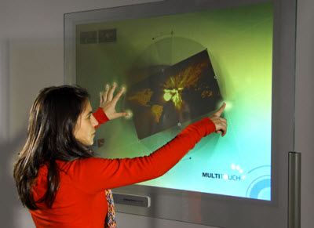
Multitouch Skin
Visual Planet makes clear flexible plastic that senses touch. Can be applied to just about anything.
Proprietary and Confidential - © Blitz Digital Studios, LLC.

Slide 6
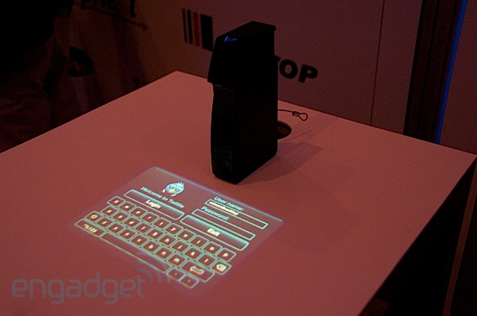
Projectors
Machine projects image onto a table, table can then be pressed and movement captured
  http://tinyurl.com/y9flgry
Runs Flash
Proprietary and Confidential - © Blitz Digital Studios, LLC.

Slide 7
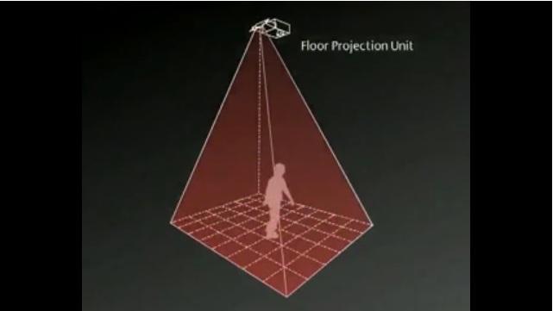
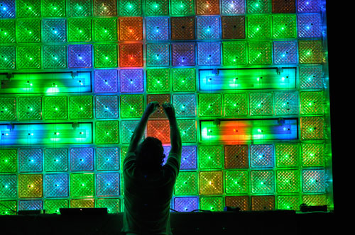
Projectors
What have others done?
  Floor Projected games
  Alternative surfaces
    Using blocks at lights →
Proprietary and Confidential - © Blitz Digital Studios, LLC.

Slide 8
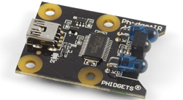
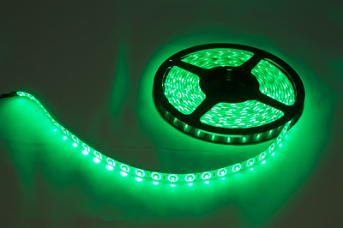
Sensors - Phidgets
Hardware that can send and receive events from flash. ex:
  IR sensor
  LED Strings
  RFID sensor
  Distance
  Touch/ pressure
  Motion
  Voltage/ Current
  Etc
Proprietary and Confidential - © Blitz Digital Studios, LLC.

Slide 9
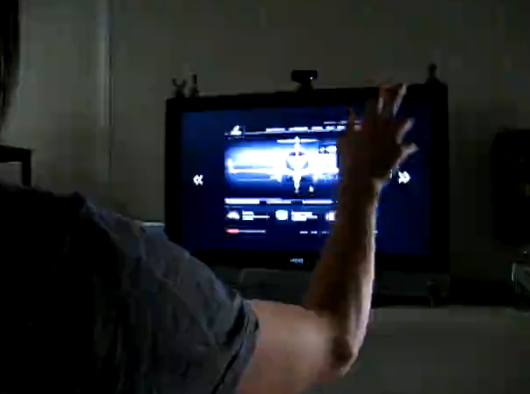
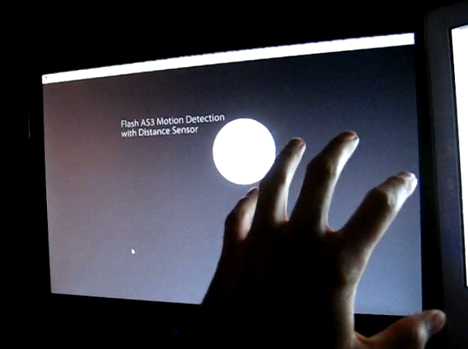
Phidget Examples
http://vimeo.com/4896410
http://vimeo.com/4895968
Proprietary and Confidential - © Blitz Digital Studios, LLC.

Slide 10

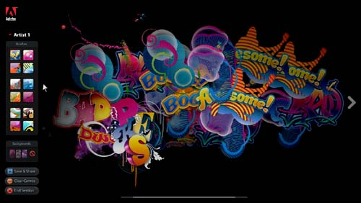
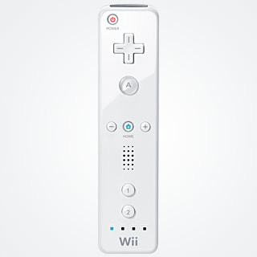
Projector Inputs
Facial Recognition
  Ex. Can move the perspective on the screen based on location of your face
Wii Motes
  Ex. Canvas project for Adobe Max
Motion Detection
  Ex. Based on movement you can move items
  Sapient example
Proprietary and Confidential - © Blitz Digital Studios, LLC.

Slide 11
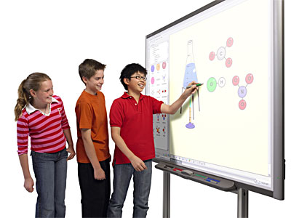
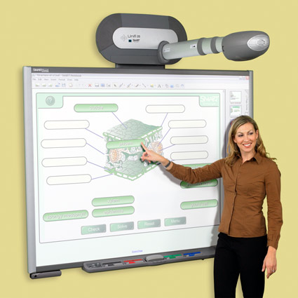
Projector Inputs
Laser Pointers
  Work the same as a mouse
Touch Screen Whiteboards
  Can be built for cheep with Wii mote
  Have more expensive pre built ones
Proprietary and Confidential - © Blitz Digital Studios, LLC.

Slide 12
Set top boxes
Apple TV, Google TV
Slew of others:
  Moviebeam
  Netgear, D-Link, both have there own
  Mvix
  Popcorn hour
  roku
All basically the same thing, a remote and different software that lets you view from a server, services (netflix etc), or your local drives
Proprietary and Confidential - © Blitz Digital Studios, LLC.

Slide 13
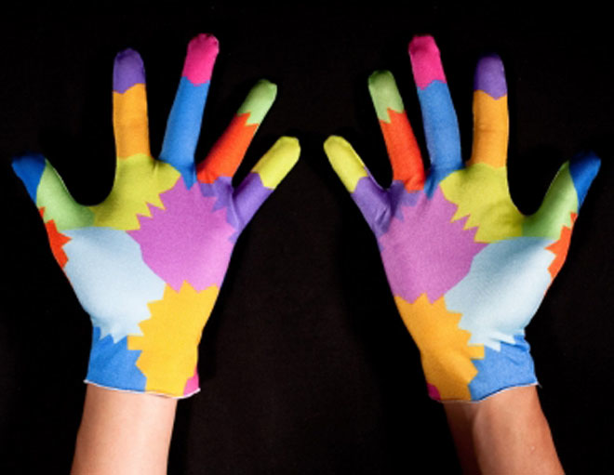
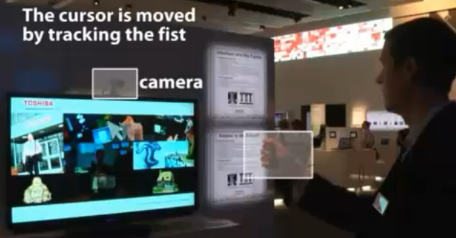
Gestures
Minority Report
http://tinyurl.com/59f8a4
http://tinyurl.com/3yjvgek
Proprietary and Confidential - © Blitz Digital Studios, LLC.

Slide 14
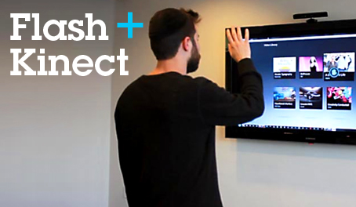
Most Recently…Kinect
It seems to be the most trendy thing to use as an input
  (BLITZ + flash + kinect)
Proprietary and Confidential - © Blitz Digital Studios, LLC.

Slide 15
Thoughts?
What Industries / Clients does the work for?
  Almost Any
Any Ideas?
  Mall touch screen games
  Digital outfit based on location and height in a fitting room
  Customize your car in a dealership using a touch screen
Proprietary and Confidential - © Blitz Digital Studios, LLC.

